Slide 1

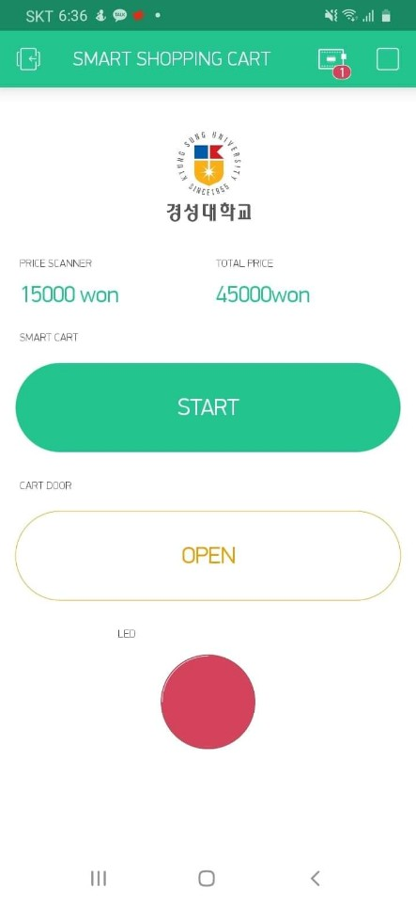
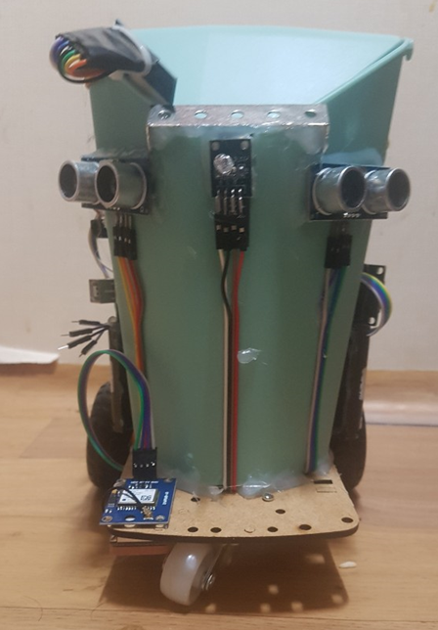
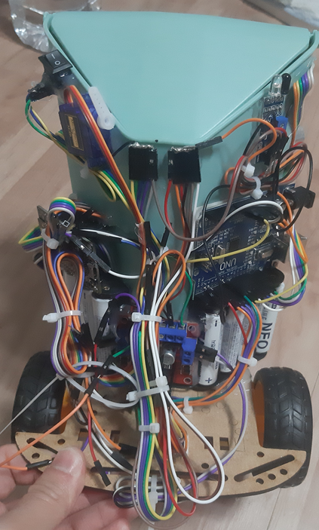
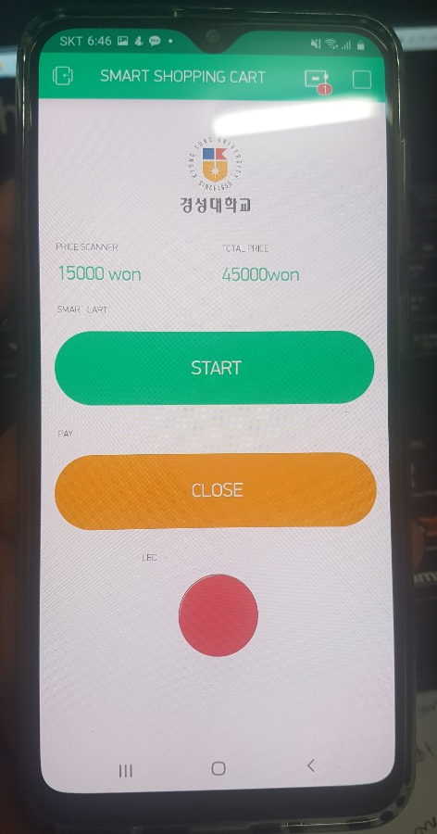
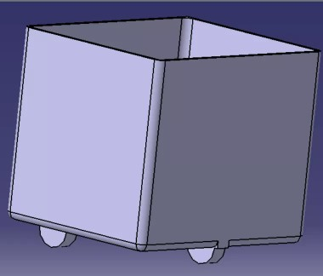
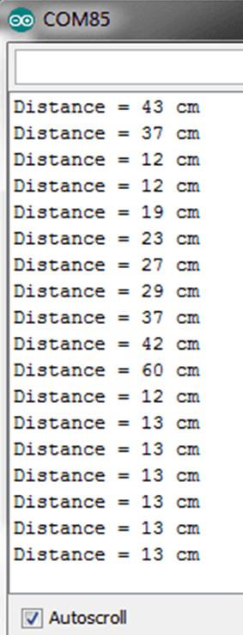
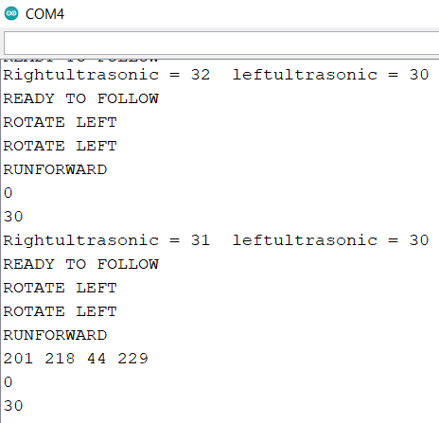
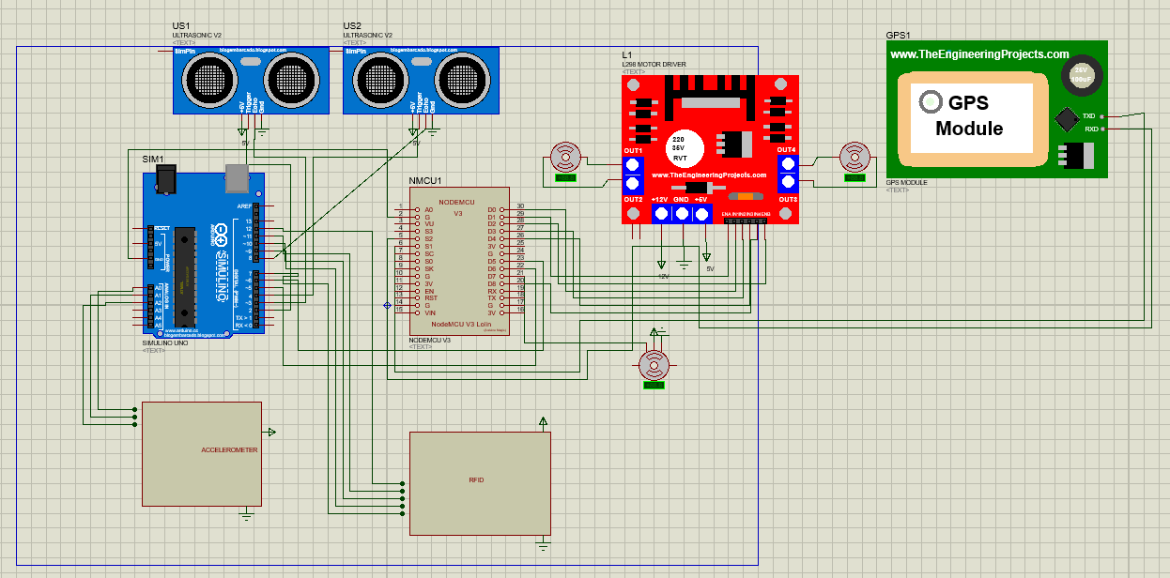
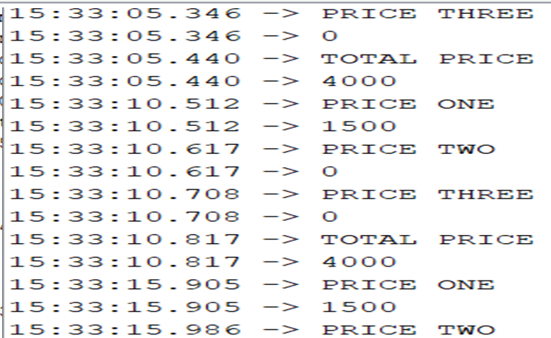
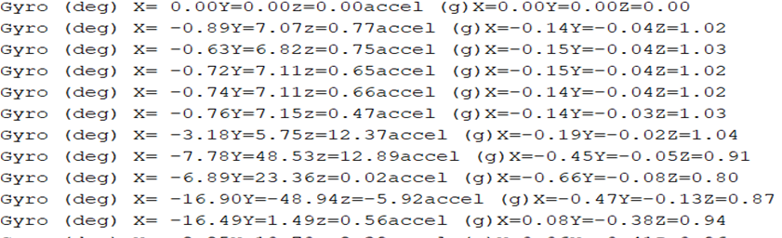
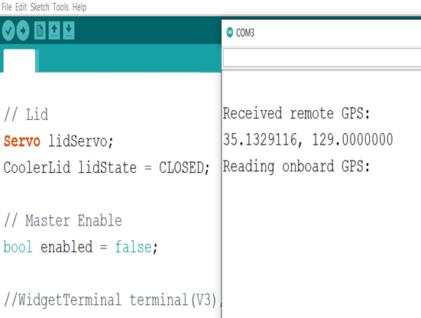
Annual Conference of IEEE IAS/IES/PELS KOREA Jt. CHAPTER Korea University, Busan, Korea Nov. 29(Fri). 2019
IoT기반 자동청구 스마트 쇼핑카트
Smart Shopping Cart with Automatic Billing System based on IoT
Tipu Sultan – Rayhan Hussain
Mechatronics Department, Kyungsung University, Busan - SouthKorea
Introduction
This smart cart can follow user when shopping, whether indoor or outdoor, and connected to their smartphone to automatically calculate total shopping price and manage the payment. To follow the user, the cart’s system uses GPS when outdoor and ultrasonic sensor when indoor. It also equipped with RF-id system which can automatically scan the amount and price of each grocery item in the cart and relay the information to user’s smartphone using IoT system. On the other hand, mobile application system enables the user to get the said information. After shopping, user must make the payment before they can take the items or exit the shopping area, or else the alarm will sound off. The resulted prototype of the smart cart is smaller than normal cart, but the system can work well although the GPS is limited to certain area.
A. System Design
C. Mobile Application for Billing System
5
The unique code from RF-Id Tag technology helps the system to recognize the product type with different price
RF-Id reader will scan the information and compare it with database
User can scan products to know the price
The total price is also shown in user’s phone
The cart is in lock condition, which means user can only put item in and cannot take it out
To take the item, user should pay using mobile apps and the cart’s door lock will open
8
1
3
2
7
6
4
9
10
Prototype
Mobile App.
1-2. Ultrasonic Sensor
3. RGB LED
4. GPS module
5. RF-id module
6. Microcontroller (Slave)
7. NodeMCU (Master)
8. Servo motor
9. Gyroscope-Accelerometer
10. Motor and Driver
D. Results and Discussion
Distance Measurement
Ultrasonic sensor works based on time and speed of sound (340 m/s) and because the sound wave will be reflected on the object, the distance is half of total travel time. The equation is:
Smart Cart Design
$$Distance= \frac{Travel Time ∗Sound Speed}{2}$$
B. Circuit Design and Flow Chart System
The stability distance data was tested and the result can be seen in this figure. The robot maintain desired distance and follow user seamlessly
RF-Id and Billing System
Gyroscope and Accelerometer
How to use smart cart?
Activate cart with your phone and stand in front of it
If both ultrasonic sensors detect user within range (50 cm), the cart will follow
Ultrasonic sensor will help point the direction and maintain the same distance to the user
If the distance between ultrasonic sensor and user < 30 cm, robot will stop and user can scan and put item inside cart
If the distance between ultrasonic sensor and user > 90 cm, robot will speed up until it stand 50 cm to the user
Position comparison was done by accelerometer – gyroscope with ultrasonic sensor to determine precise distance
GPS TEST
CONCLUSION
The smart cart prototyping can work well to follow user with constant distance and billing system can work to scan and send information to user’s phone. The RF-Id to scan and send information time is still slow in response because it use serial communication between 2 microcontrollers. Currently, this project is focused in indoor following system, and GPS is not equipped in the system. In the future, the smart cart will be made in a real system and the outdoor system will be perfected.

